Slide 1


Dushyant Patel
November 5th, 2024

Slide 2

Outline
Executive Summary
Introduction
Methodology
Results
Conclusion
Appendix

Slide 3
Executive Summary
Summary of methodologies
Data Collection through API
Data Collection with Web Scraping
Data Wrangling
Exploratory Data Analysis with SQL
Exploratory Data Analysis with Data Visualization
Interactive Visual Analytics with Folium
Machine Learning Prediction
Summary of all results
Exploratory Data Analysis result
Interactive analytics in screenshots
Predictive Analytics result

Slide 4
Introduction
Project Background and Context
SpaceX promotes its Falcon 9 rocket launches on its website at a cost of $62 million, significantly lower than competitors, who charge upwards of $165 million. This cost advantage primarily stems from SpaceX's ability to reuse the first stage of the rocket. Therefore, accurately predicting whether the first stage will successfully land can help assess the overall cost of a launch. This information could also be valuable for alternate companies looking to compete with SpaceX for rocket launch contracts. The objective of this project is to develop a machine learning pipeline to forecast the success of the first stage landing.
Key Questions to Address
What factors influence the successful landing of the rocket?
How do various features interact to determine the landing success rate?
What operational conditions are necessary to ensure a successful landing program?

Slide 5

Section 1

Slide 6
Methodology
Executive Summary
Data collection methodology:
Data was collected using SpaceX API and web scraping from Wikipedia.
Perform data wrangling
One-hot encoding was applied to categorical features
Perform exploratory data analysis (EDA) using visualization and SQL
Perform interactive visual analytics using Folium and Plotly Dash
Perform predictive analysis using classification models
How to build, tune, evaluate classification models

Slide 7
Data Collection
Data collection was conducted through various methods
Initially, we made GET requests to the SpaceX API to retrieve data.
We then decoded the response content as JSON using the .json() function and transformed it into a pandas DataFrame with the .json_normalize() method.
After that, we cleaned the data by checking for missing values and filling in those values where necessary.
Additionally, we performed web scraping on Wikipedia to obtain Falcon 9 launch records using BeautifulSoup.
The goal was to extract the launch records from an HTML table, parse the table, and convert it into a pandas DataFrame for further analysis.

Slide 8
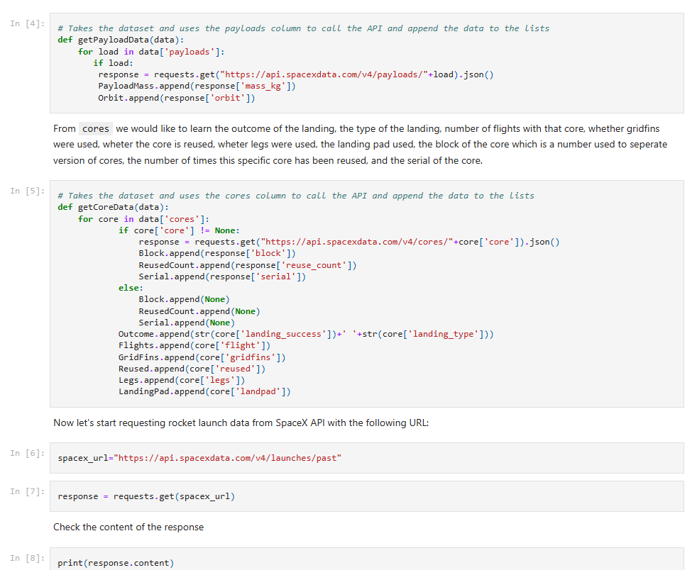
Data Collection – SpaceX API
We utilized GET requests to the SpaceX API to collect data, followed by cleaning the retrieved data and performing basic data wrangling and formatting.
GitHub URL: https://github.com/dkpatel369/Applied-Data-Science-Capstone/blob/de298a4b66f47b403d53e37031196b6dbb218944/Hands-On%20Lab%3A%20Data%20Collection.ipynb

Slide 9
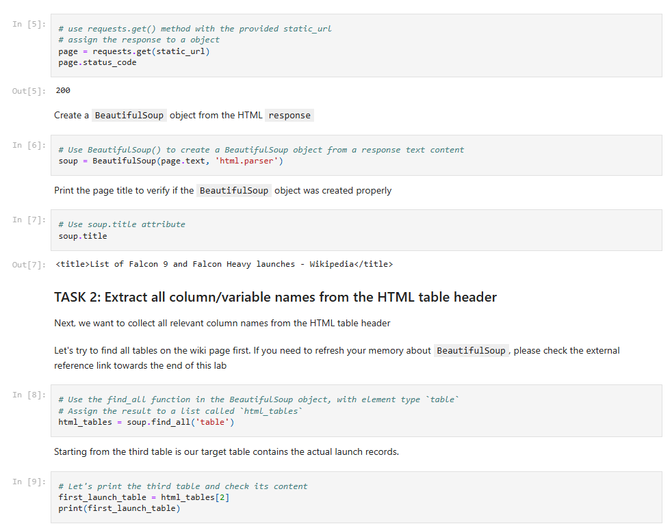
Data Collection - Scraping
We applied web scrapping to web scrap Falcon 9 launch records with BeautifulSoup
We parsed the table and converted it into a pandas DataFrame.
GitHub URL: https://github.com/dkpatel369/Applied-Data-Science-Capstone/blob/de298a4b66f47b403d53e37031196b6dbb218944/Hands-On%20Lab%3A%20Data%20Collection%20with%20Web%20Scraping.ipynb

Slide 10

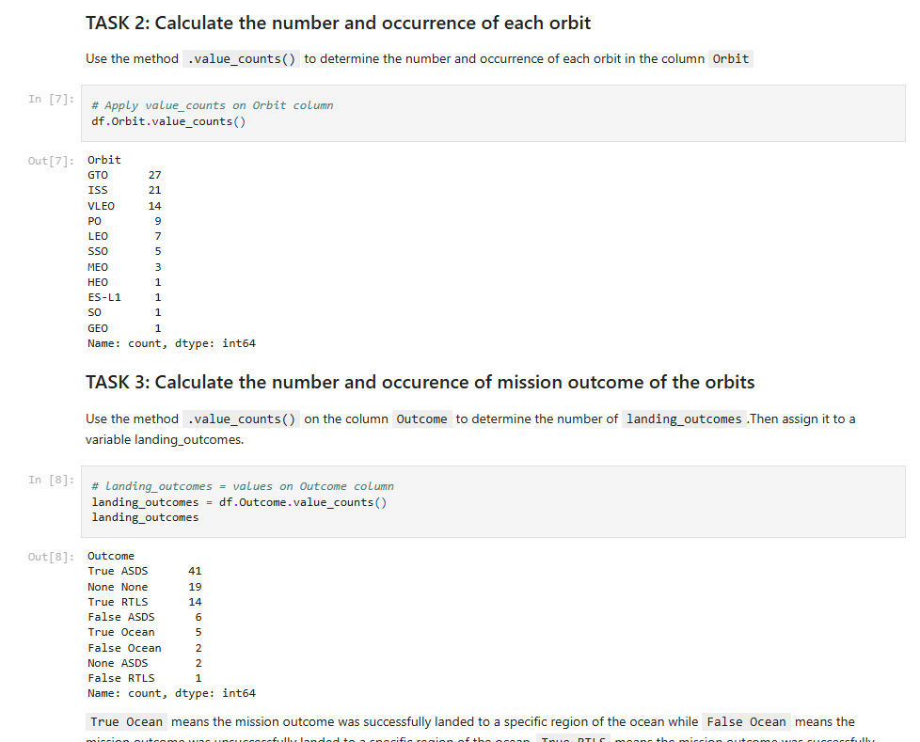
Data Wrangling
We conducted exploratory data analysis to define the training labels. We calculated the number of launches at each site and analyzed the frequency of each orbit type. Additionally, we generated landing outcome labels from the outcome column and exported the results to a CSV file.
The handful of mission outcome types were converted to a binary classification where 1 means that the Falcon 9 first stage landing was a success and 0 means that it was a failure.
GitHub URL: https://github.com/dkpatel369/Applied-Data-Science-Capstone/blob/de298a4b66f47b403d53e37031196b6dbb218944/Hands-On%20Lab%3A%20Data%20Wrangling.ipynb

Slide 11
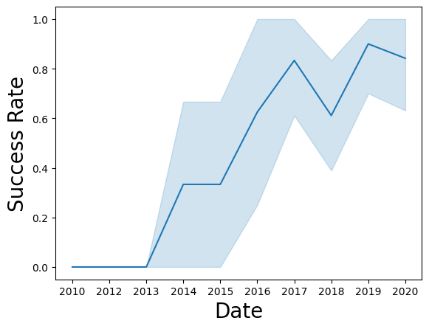
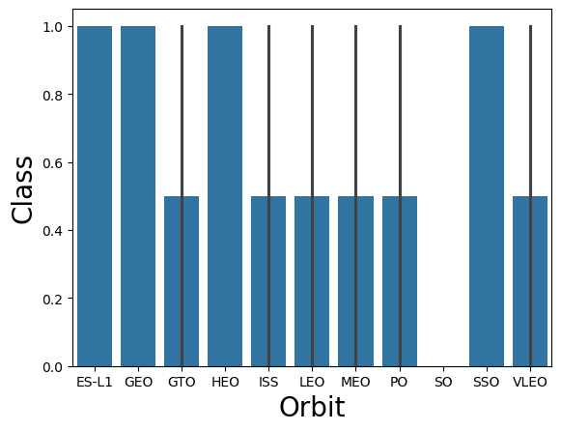
EDA with Data Visualization
We examined the data by visualizing the relationships between flight number and launch site, payload and launch site, success rates for each orbit type, flight number and orbit type, as well as the yearly trend of launch success.
GitHub URL: https://github.com/dkpatel369/Applied-Data-Science-Capstone/blob/de298a4b66f47b403d53e37031196b6dbb218944/Hands-On%20Lab%3A%20EDA%20with%20Visualization%20Lab.ipynb

Slide 12
EDA with SQL
We loaded the SpaceX dataset into a PostgreSQL database directly from the Jupyter notebook. We then performed exploratory data analysis using SQL to gain insights from the data. We wrote queries to determine:
The names of unique launch sites in the space mission.
The total payload mass carried by boosters launched by NASA (CRS).
The average payload mass for the booster version F9 v1.1.
The total number of successful and failed mission outcomes.
The failed landing outcomes on drone ships, including the corresponding booster versions and launch site names.
GitHub URL: https://github.com/dkpatel369/Applied-Data-Science-Capstone/blob/de298a4b66f47b403d53e37031196b6dbb218944/Hands-on%20Lab%3A%20Complete%20the%20EDA%20with%20SQL.ipynb

Slide 13
Build an Interactive Map with Folium
We marked all launch sites, and added map objects such as markers, circles, lines to mark the success or failure of launches for each site on the folium map.
We assigned the feature launch outcomes (failure or success) to class 0 and 1.i.e., 0 for failure, and 1 for success.
Using the color-labeled marker clusters, we identified which launch sites have relatively high success rate.
We calculated the distances between a launch site to its proximities. We answered some question for instance:
Are launch sites near railways, highways and coastlines.
Do launch sites keep certain distance away from cities.
GitHub URL: https://github.com/dkpatel369/Applied-Data-Science-Capstone/blob/de298a4b66f47b403d53e37031196b6dbb218944/Hands-on%20Lab%3A%20Interactive%20Visual%20Analytics%20with%20Folium%20lab.ipynb

Slide 14
Build a Dashboard with Plotly Dash
The input dropdown is used to select one or all launch sites for the pie chart and scatterplot.
The pie chart displays one of two things:
For All Sites – the distribution of successful Falcon 9 first stage landings between the sites
For One Site – the distribution of successful and failed Falcon 9 first stage landings for that site
The input slider is used to filter the payload masses for the scatterplot.
The scatterplot displays the distribution of Falcon 9 first stage landings split by payload mass, mission outcome and by booster version category
GitHub URL: https://github.com/dkpatel369/Applied-Data-Science-Capstone/blob/de298a4b66f47b403d53e37031196b6dbb218944/Hands-on%20Lab%3A%20Build%20an%20Interactive%20Dashboard%20with%20Ploty%20Dash.py

Slide 15
Predictive Analysis (Classification)
The dataset was split into training and testing sets.
Logistic Regression, SVM (Support Vector Machine), Decision Tree, and KNN (k-Nearest Neighbors) machine learning models were trained on the training data set.
Hyper-parameters were evaluated using GridSearchCV() and the best was selected using ‘.best_params_’.
Using the best hyper-parameters, each of the four models were scored on accuracy by using the testing data set.
GitHub URL: https://github.com/dkpatel369/Applied-Data-Science-Capstone/blob/de298a4b66f47b403d53e37031196b6dbb218944/Hands-on%20Lab%3A%20Complete%20the%20Machine%20Learning%20Prediction%20lab.ipynb

Slide 16
Results
Exploratory data analysis results
Interactive analytics demo in screenshots
Predictive analysis results

Slide 17

Section 2

Slide 18
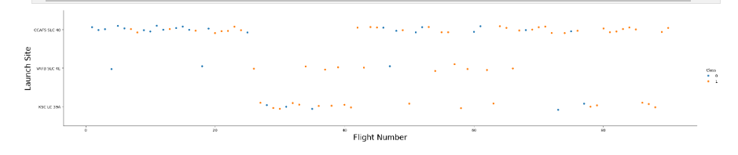
Flight Number vs. Launch Site
From the plot, we observed that a higher number of flights at a launch site is associated with a greater success rate.

Slide 19
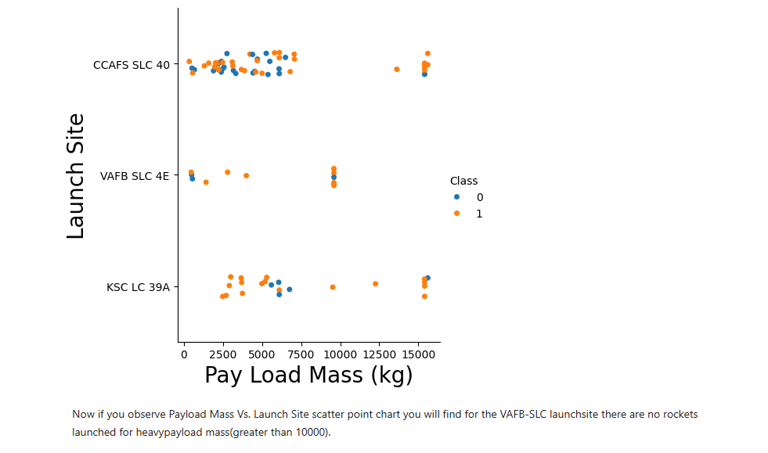
Payload vs. Launch Site
For the CCAFS SLC 40 launch, the payload mass and the landing outcome appear not to be strongly correlated.
The failed landings at the KSC LC 39A launch site are all grouped around a narrow band of payload masses.

Slide 20
Success Rate vs. Orbit Type
ES-L1, SSO, HEO and GEO orbits have no failed first stage landings.
SO orbits have no successful first stage landings.

Slide 21
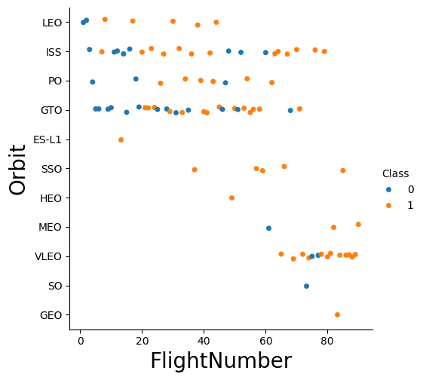
Flight Number vs. Orbit Type
There is a correlation between flight number and success rate with larger flight numbers being associated with higher success rates.

Slide 22
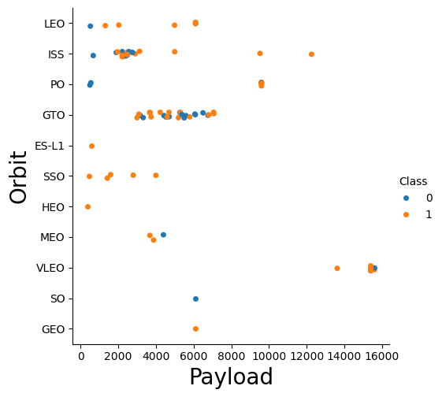
Payload vs. Orbit Type
Some orbit types have better success rates than others.
Success rate appears to have no obvious correlation with payload mass.

Slide 23
Launch Success Yearly Trend
The success rate has increased significantly over the years.

Slide 24
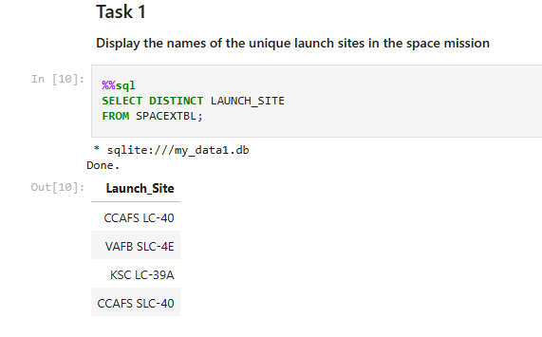
All Launch Site Names
Unique Launch Sites:
There are 4 unique launch sites.

Slide 25
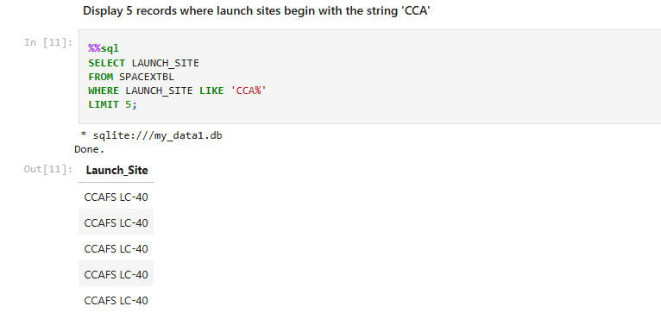
Launch Site Names Begin with 'CCA'
5 records where launch sites begin with `CCA`

Slide 26
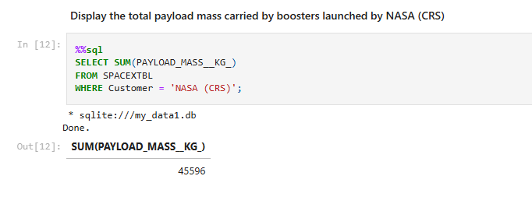
Total Payload Mass
The total payload carried by boosters from NASA is 45596 kg.

Slide 27
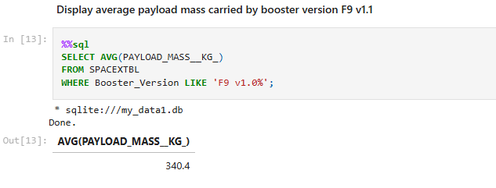
Average Payload Mass by F9 v1.1
Average payload mass carried by booster version F9 v1.1 is 340.4 kg.

Slide 28
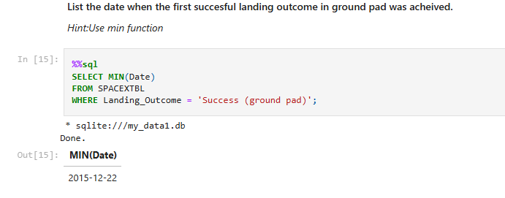
First Successful Ground Landing Date
First successful landing outcome on ground pad date is Dec. 22nd, 2015.

Slide 29
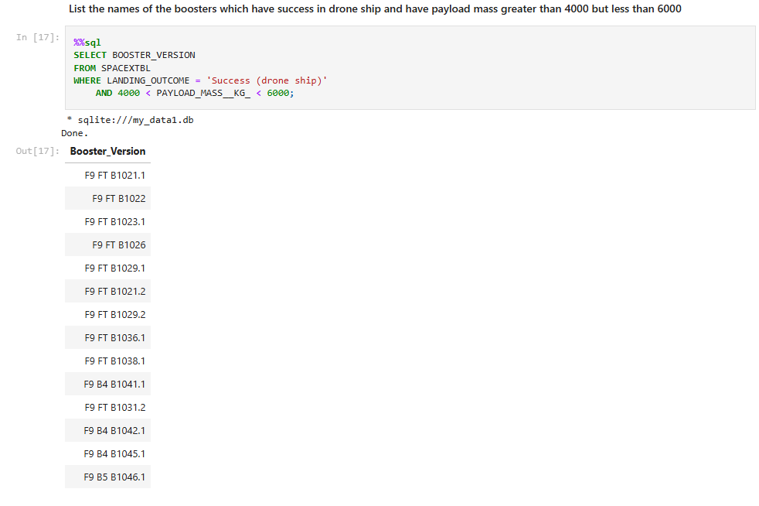
Successful Drone Ship Landing with Payload between 4000 and 6000
List of names of boosters which have successfully landed on drone ship and had payload mass greater than 4000 but less than 6000

Slide 30
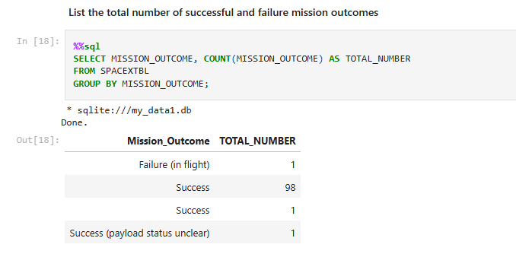
Total Number of Successful and Failure Mission Outcomes
The total number of successful and failure mission outcomes

Slide 31
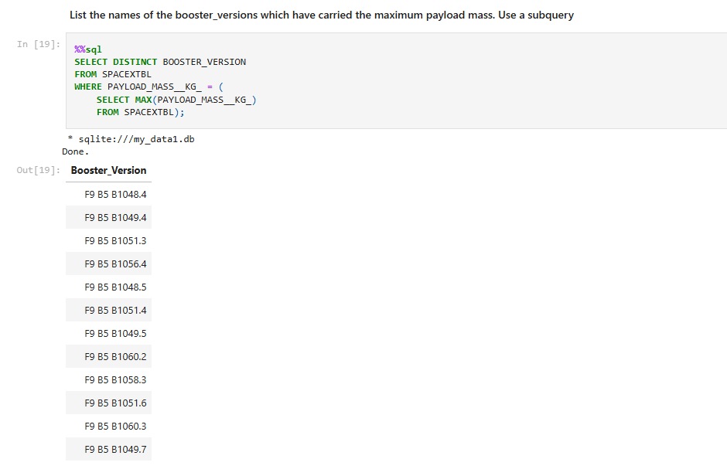
Boosters Carried Maximum Payload
Names of the booster which have carried the maximum payload mass.

Slide 32
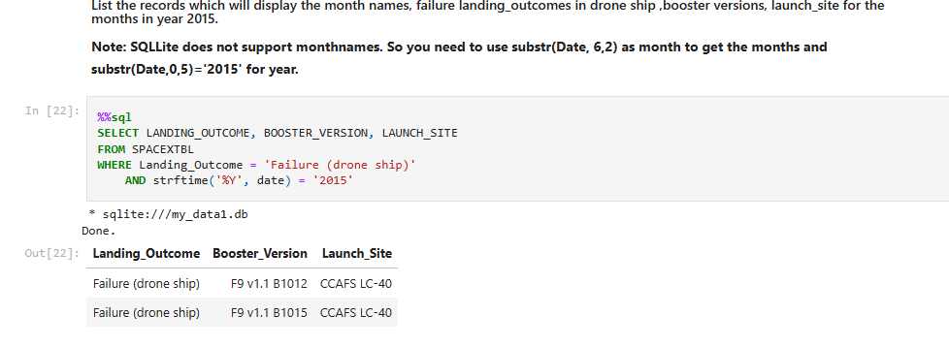
2015 Launch Records
Failed landing_outcomes in drone ship, their booster versions, and launch site names for in year 2015

Slide 33
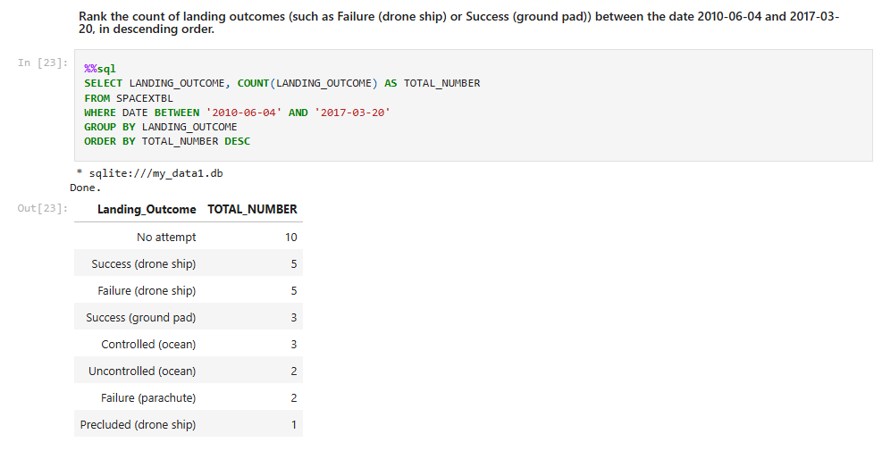
Rank Landing Outcomes Between 2010-06-04 and 2017-03-20
Rank the count of landing outcomes (such as Failure (drone ship) or Success (ground pad)) between the date 2010-06-04 and 2017-03-20, in descending order

Slide 34

Section 3

Slide 35
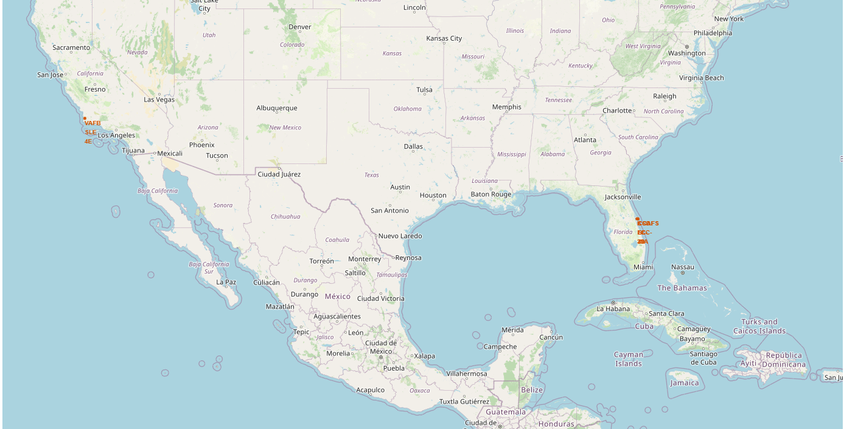
All Launch Sites (GLOBAL)
VAFB SLC-4E (California, USA)
Vandenberg Air Force Base Space Launch Complex 4E
KSC LC-39A (Florida, USA)
Kennedy Space Center Launch Complex 39A
CCAFS LC-40 (Florida, USA)
Cape Canaveral Air Force Station Launch Complex 40
CCAFS SLC-40 (Florida, USA)
Cape Canaveral Air Force Station Space Launch Complex 40

Slide 36

Markers showing launch sites with color labels

Slide 37

Launch Site distance to landmarks

Slide 38

Section 4

Slide 39
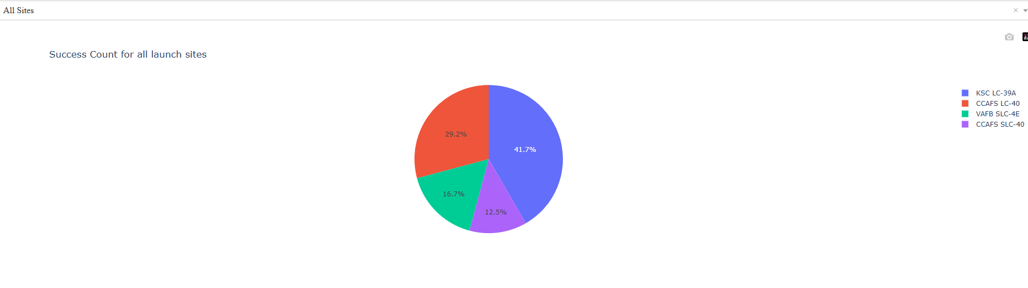
Success Counts for all Launch Sites
The dropdown menu allows the selection of one or all launch sites.
With all launch sites selected, the pie chart displays the distribution of successful Falcon 9 first stage landing outcomes between the different launch sites.
The greatest share of successful Falcon 9 first stage landing outcomes (at 41.7% of the total) occurred at KSC LC-39A.

Slide 40
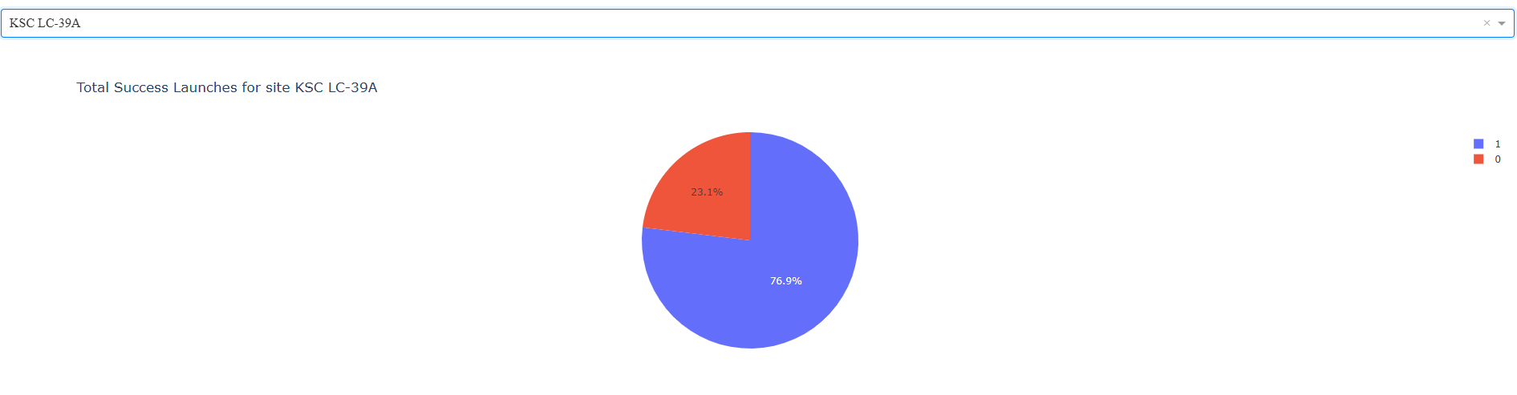
Launch site with Highest Launch Success Ratio
KSC LC-39A has the highest launch success ratio of 76.9% and failure of 23.1%

Slide 41
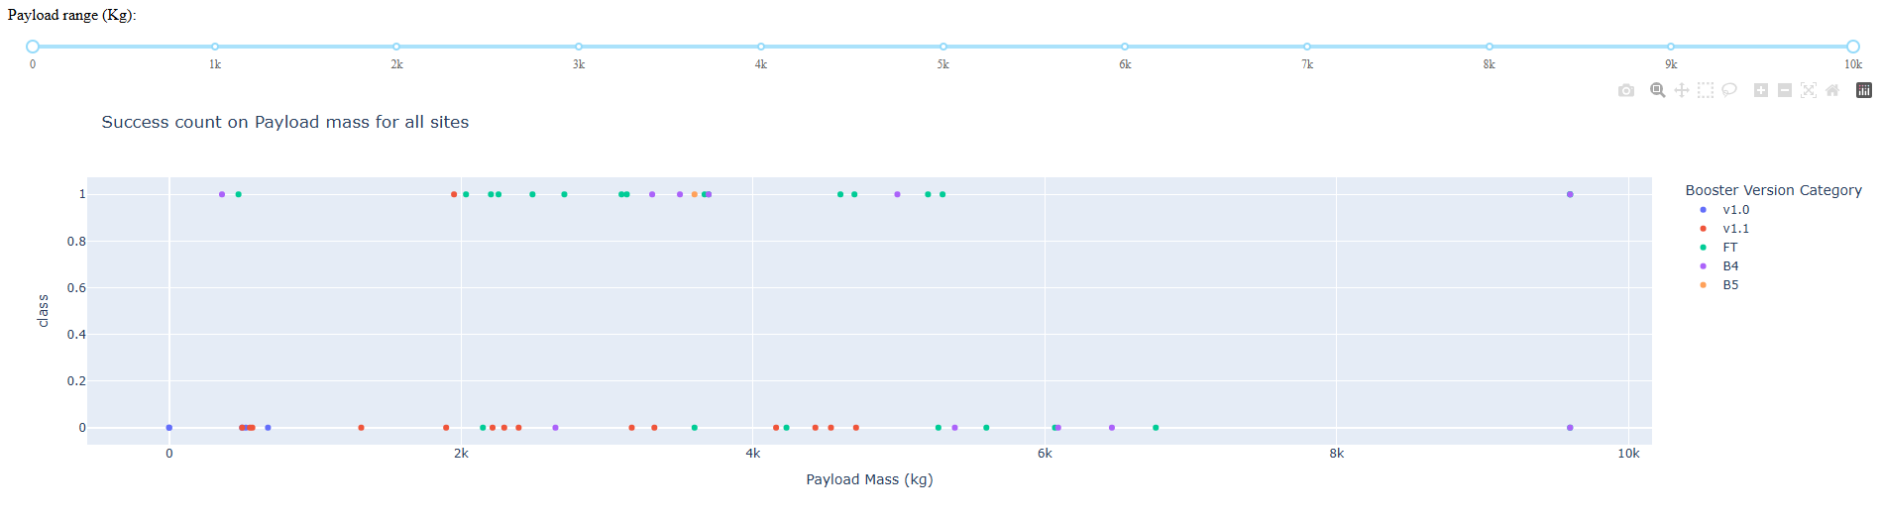
Payload vs Launch Outcome Scatter Plot
The payload range from about 2,000 kg to 5,000 kg has the highest success rate.
The ‘FT’ booster version category has the largest success rate.

Slide 42

Section 5

Slide 43
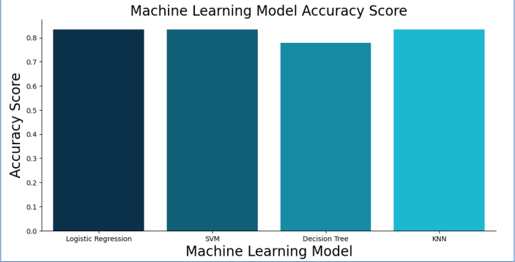
Classification Accuracy
All models performed equally well except for the Decision Tree model which performed poorly relative to the other models.

Slide 44

Confusion Matrix
The confusion matrix for the decision tree classifier shows that the classifier can distinguish between the different classes. The major problem is the false positives .i.e., unsuccessful landing marked as successful landing by the classifier.
Prediction Breakdown:
12 True Positives and 3 True Negatives
3 False Positives and 0 False Negatives

Slide 45
Conclusions
A higher volume of flights at a launch site correlates with a greater success rate.
The launch success rate showed an upward trend from 2013 to 2020.Orbits ES-L1, GEO, HEO, SSO, and VLEO achieved the highest success rates.
The KSC LC-39A site had the highest number of successful launches among all sites.
The Decision Tree classifier proved to be the most effective machine learning algorithm for this analysis.

Slide 46
Appendix
Initial Data Sets
SpaceX API (JSON): https://cf-courses-data.s3.us.cloud-object-storage.appdomain.cloud/IBM-DS0321EN-SkillsNetwork/datasets/API_call_spacex_api.json
Wikipedia (Webpage): https://en.wikipedia.org/w/index.php?title=List_of_Falcon_9_and_Falcon_Heavy_launches&oldid=1027686922
SpaceX (CSV): https://cf-courses-data.s3.us.cloud-object-storage.appdomain.cloud/IBM-DS0321EN
Launch Geo (CSV): https://cf-courses-data.s3.us.cloud-object-storage.appdomain.cloud/IBM-DS0321EN-SkillsNetwork/datasets/spacex_launch_geo.csv
Launch Dash (CSV): https://cf-courses-data.s3.us.cloud-object-storage.appdomain.cloud/IBM-DS0321EN-SkillsNetwork/datasets/spacex_launch_dash.csv

Slide 47


